Slide 1
Recent Controlled Approaches on Conditional Text Generation
Hongru
2021-03-26
/ 21
Notes:
This talk is a brief survey about conditional text generations. I’ll try to show you my understanding about the recent approaches on conditional text generation tasks.

Slide 2
Outline
Introduction
Recent approaches
CTRL[1]
PPLM[2]
GDC[3]
Discussion & Conclusion
Comparison
Pros and cons
Possible future directions
[1] Nitish S Keskar, et al. CTRL: A Conditional Transformer Language Model for Controllable Generation arixv 2019
[2] Dathathri, et al. Plug and Play Language Model: A Simple Approach to Controlled Text Generation. ICLR 2020
/ 21
[3] Khalifa, et al. A Distributional Approach to Controlled Text Generation. ICLR 2021

Slide 3
Introduction
All of the text generation tasks is to meet a specific condition.
Related tasks:
A question sentence
Texts about specific topics
Comments given sentiments
Story Ending Generation
Cause & effects(aNLG)
Multiturn dialogue
Summary
…
/ 21
Notes:
To some extent, <1>. Or we say the requirements of the tasks.

Slide 4
Introduction
All of the text generation tasks is to meet a specific condition.
Related tasks:
A question sentence
Texts about specific topics
Comments given sentiments
Story Ending Generation
Cause & effects(aNLG)
Multiturn dialogue
Summary
…
[Science] The potato was once thought to have no health problems and has been promoted as a nutritious food source … In fact, researchers from Johns Hopkins University …
/ 21
Notes:
Given the prefix or prompt sentence `the potato` and the topic `science`. The model should write something about scientific topics.

Slide 5
Introduction
All of the text generation tasks is to meet a specific condition.
Related tasks:
A question sentence
Texts about specific topics
Comments given sentiments
Story Ending Generation
Cause & effects(aNLG)
Multiturn dialogue
Summary
…
[Negative] The potato is a pretty bad idea. It can make you fat, it can cause you to have a terrible immune system, and it can even kill you …
/ 21
Notes:
In some task the model needs to write comments with the given sentiment. We can see that as long as some key words appears in the generated text, we can say the condition is satisfied.

Slide 6
Introduction
All of the text generation tasks is to meet a specific condition.
Related tasks:
A question sentence
Texts about specific topics
Comments given sentiments
Story Ending Generation
Cause & effects(aNLG)
Multiturn dialogue
Summary
…
[1] Mr. Egg was presenting a volcanic eruption to the science class.
[2] He has a diagram of a volcano that looked like it was made of tinfoil.
[3] He then took out a huge thing of vinegar and started to pour it in !
[4] The class had no clue what was going on and looked on in astonishment.
[Ending] The volcano then exploded with substance that looked like lava!
/ 21
Notes:
In story ending generation task, we need to write down the ending given the four line story. The ending should be reasonable and coherent to the context.

Slide 7
Introduction
All of the text generation tasks is to meet a specific condition.
Related tasks:
A question sentence
Texts about specific topics
Comments given sentiments
Story Ending Generation
Cause & effects(aNLG)
Multiturn dialogue
Summary
…
[O1] Jenny cleaned her house and went to work, leaving the window just a crack open.
[H] A thief broke into the house by pulling open the window.
[O2] When Jenny returned home she saw that her house was a mess!
/ 21
Notes:
In a recent task aNLG, we need to write down the hypothesis between two observations. You can regard it as another type of story generation tasks, but more challenging, because the mid sentence should bridge the context well.
The ending should be reasonable and coherent to the context. The condition definition is much more abstract and difficult to meet.

Slide 8
Introduction
All of the text generation tasks is to meet a specific condition.
Related tasks:
A question sentence
Texts about specific topics
Comments given sentiments
Story Ending Generation
Cause & effects(aNLG)
Multiturn dialogue
Summary
…
Conditions
Definition more and more abstract
More and more difficult
/ 21
Notes:
In my understanding, from the top to the bottom, the condition is more and more abstract, and the satisfying them is more and more difficult.
The approaches introduced later focused on these two tasks. While the rest of tasks are still under-studied.

Slide 9
Outline
Introduction
Recent approaches
CTRL[1]
PPLM[2]
GDC[3]
Discussion & Conclusion
Comparison
Pros and cons
Possible future directions
[1] Nitish S Keskar, et al. CTRL: A Conditional Transformer Language Model for Controllable Generation arixv 2019
[2] Dathathri, et al. Plug and Play Language Model: A Simple Approach to Controlled Text Generation. ICLR 2020
/ 21
[3] Khalifa, et al. A Distributional Approach to Controlled Text Generation. ICLR 2021

Slide 10

Approaches
Problem Formalization
Find a language model under specific condition.
Challenges:
How to define and model the condition
How to train the model
/ 21
Notes:
Generally speaking, to solve the conditional text generation task, we need to find a language model under specific conditions. p of x given a, where x is the text and a is the condition. In some paper they call it attribute so it is a for short. The challenges are two fold. How to define and model the condition a and how to train the model. All of the following papers need to address these two challenges, but from different aspects.

Slide 11
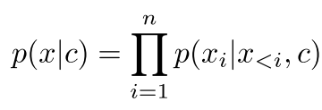
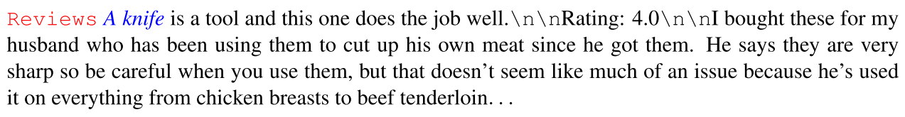
Approaches - CTRL
Directly modeling by control codes
A pretrained work similar to GPT2
140GB of text (Wikidata, OpenWebText,…, TrivialQA, …,)
Training on sequences of raw text prepended with control codes.
Nitish S Keskar, et al. CTRL: A Conditional Transformer Language Model for Controllable Generation arixv 2019
/ 21
Notes:
The first work is CTRL. It directly model the language model p of x given a by control codes. here c means the control codes. It fullfills this goal by bring the help of pretraining on large amount of corpus. They used about 140 gigabytes of data. The training object is to learn the language model on raw text prepended by the control codes. The following is the an example. The red text is the control codes, the blue is the prefix. It means it writes some review given the prefix.

Slide 12
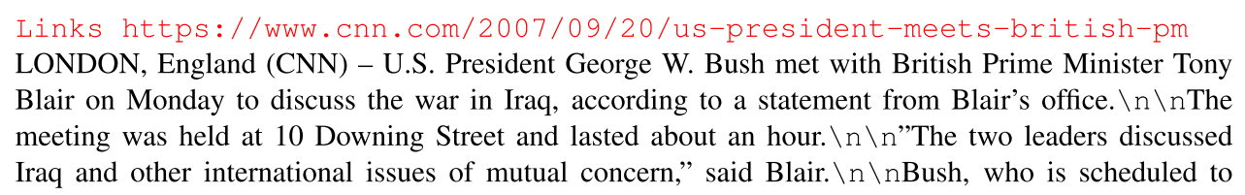
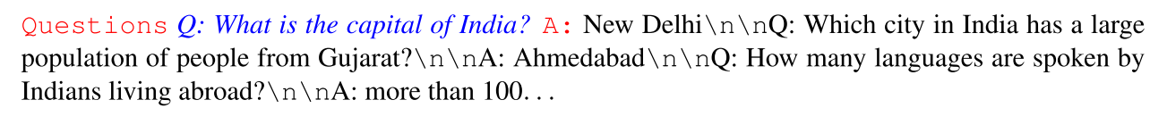
Approaches - CTRL
Pros
Rich control codes, even including html links, questions.
Cons
Rely on too large amount of data.
Hard to fine-tune.
Keskar, et al. CTRL: A Conditional Transformer Language Model for Controllable Generation arixv 2019
/ 21
Notes:
Hard to adapt to other conditional tasks.

Slide 13
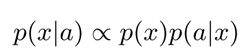

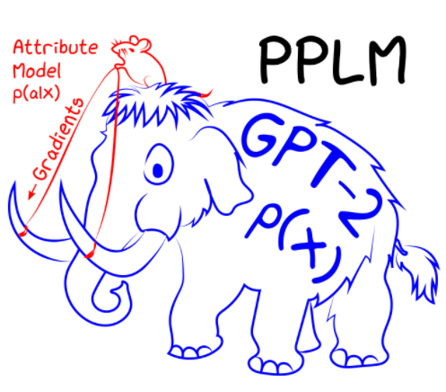

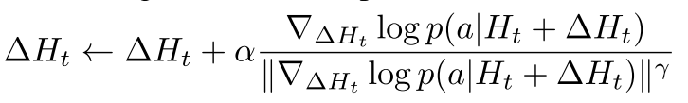
Approaches - PPLM
Modeling instead.
Just need to train attribute model
Control the generation by updating the hidden states of language models
Essentially a new decoding strategy.
Dathathri, et al. Plug and Play Language Model: A Simple Approach to Controlled Text Generation. ICLR 2020
/ 21

Slide 14
Approaches - PPLM
Pros:
No need to fine-tuned the language model
Use much less data than CTRL
Cons:
The attribute model p(a|x) takes partial sentence as input, which cannot model complicated attribute.
Dathathri, et al. Plug and Play Language Model: A Simple Approach to Controlled Text Generation. ICLR 2020
/ 21

Slide 15


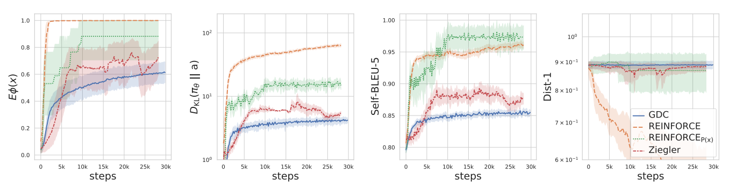
Approaches – GDC
Modeling by Energy-Based Model
The attribute model satisfied
E.g.: in sentiment task, \phi(x) is a classifier judging the sentence x, \mu can be 1.
Approximate the optimal model by RL algorithm.
Khalifa, et al. A Distributional Approach to Controlled Text Generation. ICLR 2021
/ 21
Notes:
Energy-based Model is a proposed by Lecun et al in about 20 years ago. We don’t explain the detail of this EBM in this talk, just keep in mind that the EBM bring language model and attribute model together. Then they can control the generated text by setting expectation mu.
The EBM is not a autoregression model, so they need to approximate it using another language model by RL algorithm.
It differs from other RL algorithm, but the algorithm is a little bit complicated, so we just see the results. Basically, they have a better trade-off between RL rewards and text quality.

Slide 16
Approaches - GDC
GDC
REINFORCE
Ziegler[1]
[1] Ziegler, et al. Fine-tuning Language Model from Human Preferences. arxiv 2019
/ 21

Slide 17
Approaches – GDC
Pros:
Modeling the whole sentences.
Any advanced classifier can be used here, more flexible.
Cons:
Training procedure is too complicated.
For challenging tasks, the results not good yet, need more adaption.
Khalifa, et al. A Distributional Approach to Controlled Text Generation. ICLR 2021
/ 21
Notes:
Energy-based Model is a proposed by Lecun et al in about 20 years ago. We don’t explain the detail of this EBM in this talk, just keep in mind that the EBM bring language model and attribute model together. Then they can control the generated text by setting expectation mu.
The EBM is not a autoregression model, so they need to approximate it using another language model by RL algorithm.
It differs from other RL algorithm, but the algorithm is a little bit complicated, so we just see the results. Basically, they have a better trade-off between RL rewards and text quality.

Slide 18
Approaches - Comparison
Modeling
CTRL:
PPLM:
GDC:
Data:
CTRL: large amount of raw text
PPLM: data for p(a|x)
GDC: data for p(x) and \phi(x)
Training
CTRL: pretrain with prepended control code
PPLM: train p(a|x)
GDC: fine-tune p(x), train \phi(x), finally train by RL
/ 21

Slide 19
Approaches - Comparison
Generating positive comments
GDC
PPLM
CTRL
/ 21

Slide 20
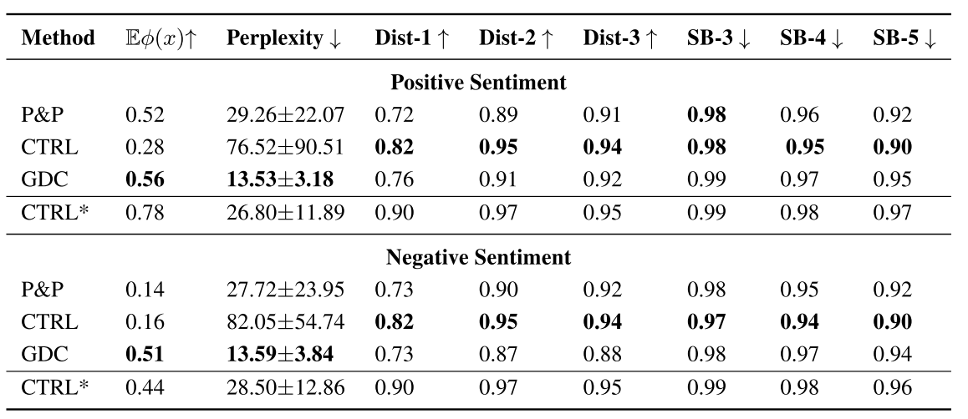
Approaches - Comparison
/ 21
Notes:
Here, we see a clear advantage of GDC in terms of constraint satisfaction and perplexity and a comparable performance in terms of diversity against PPLM and CTRL.
15With

Slide 21
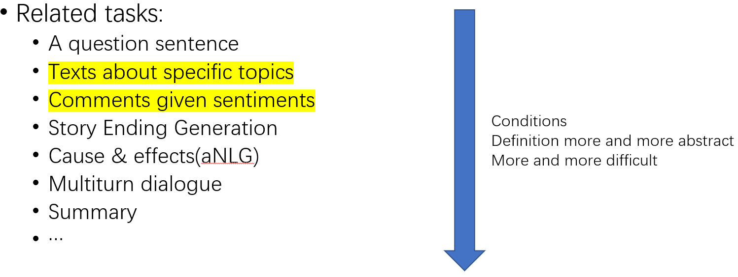
Discussion & Conclusion
Recent work on controlled text generation showed promising results on simple generation tasks.
Adapting these approaches to other conditional generation task is challenging:
Definition of the conditions, e.g.: what is a coherent and reasonable ending?
The quality of the p(a|x) or \phi(x)
/ 21

